Slide 1
Session 3
AMBITIONS
HOW SATCOM CAN ADDRESS THE SECURITY AND GEOPOLITICAL ENVIRONMENT CHALLENGES

Slide 2
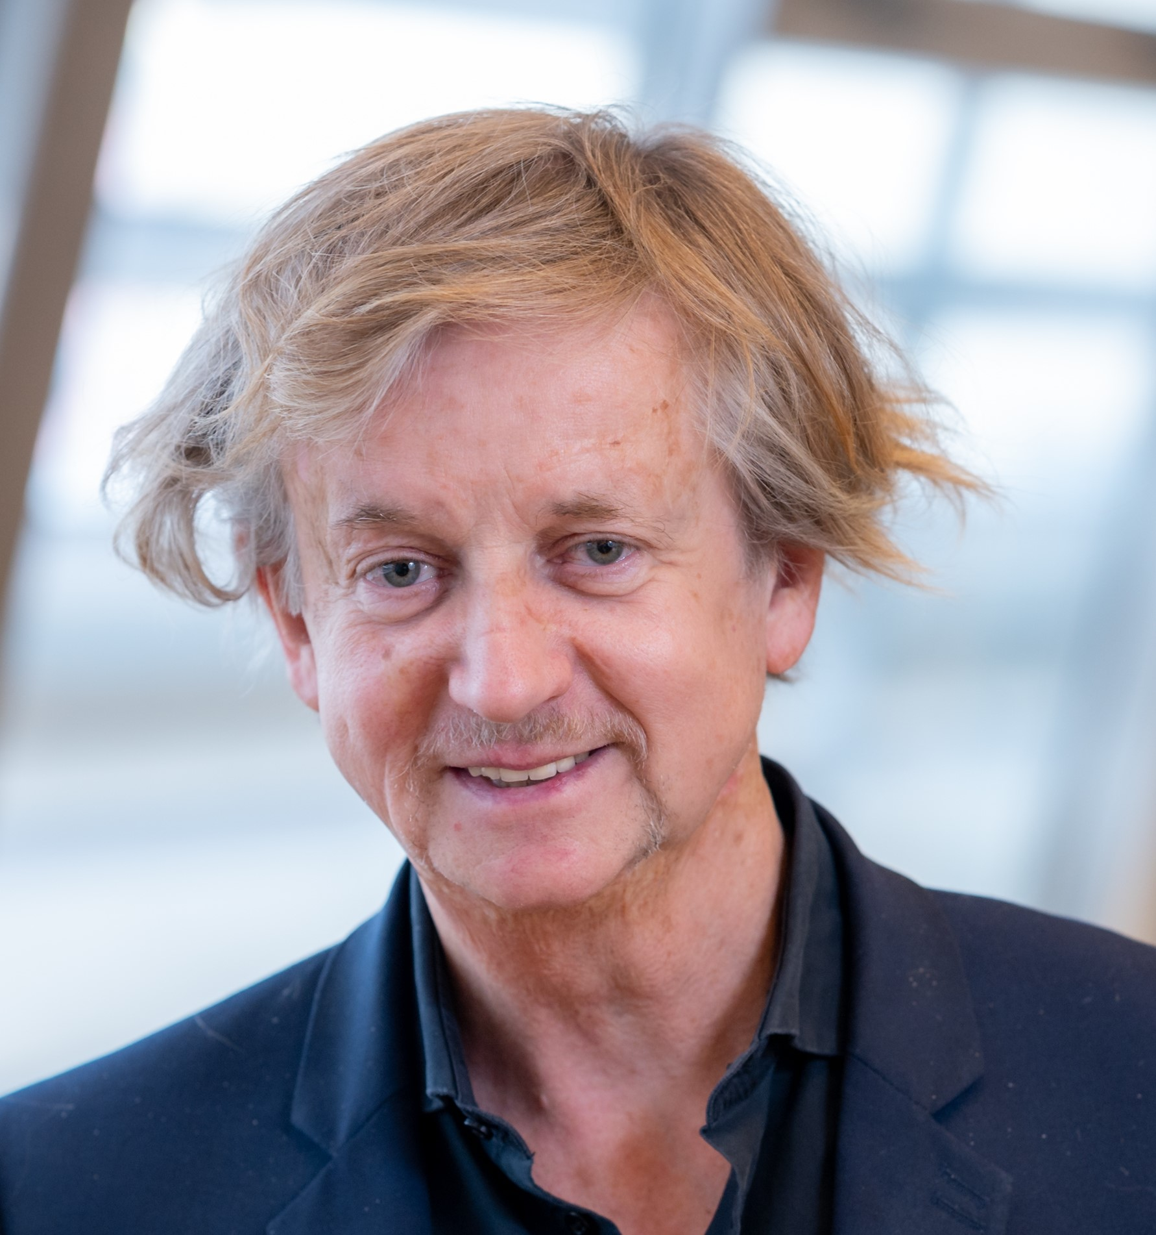
Hermann Ludwig Moeller is the director of the European Space Policy Institute (ESPI), the Vienna-based European Think Tank for Space. With the ESPI team, he supports the work of the High-Level Advisory Group (HLAG).
Moeller's earlier responsibilities include head of Strategy at ESA's Programme and Transformation Office at the Telecommunications Directorate and head of the Copernicus Space Segment Office at the ESA Earth Observation Directorate.
Ludwig Moeller
Director
European Space Policy Institute (ESPI)

Slide 3
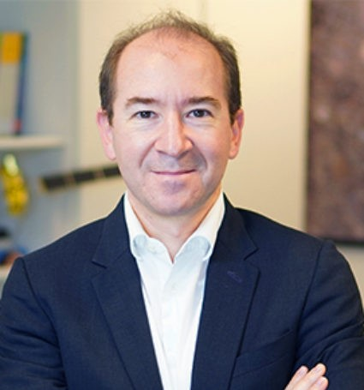
Pacôme Révillon is Chief Executive Officer of Euroconsult, based in Paris, France. In his 18 years working in the space sector, Pacôme has led Euroconsult’s strategy and operations and consults with high-level clients, particularly in satellite broadcasting, communications and finance.
Under his management, the company has experienced a continuous expansion internationally, and has strengthened its position as an international reference on the strategic, economic and financial aspects of space activities.
His work experience includes positions with the DLR in Germany and Thales in France. He holds a graduate engineering degree in telecommunications & space from SUPAERO and a Master’s in economics from DESIA.
Pacôme Révillon
CEO
Euroconsult

Slide 4
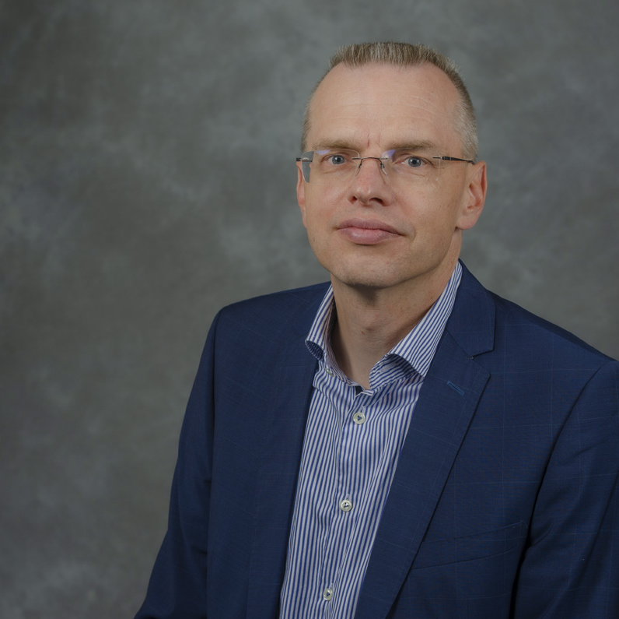
Christoph Kautz is head of Unit for Secure Connectivity, Space Surveillance and Applications in DG Defence Industry and Space of the European Commission.
In 2020, Kautz was acting head of Unit for Space Research, Innovation and Start-ups. Between 2013 and 2019, he was Deputy Head of Unit for Galileo and EGNOS – Applications, Security and International Cooperation. Since joining the Commission in 2000, he has held several positions dealing with a variety of industry and Internal Market issues. Prior to the Commission, he worked for 6 years as public affairs consultant.
Kautz holds a degree in history and politics, as well as a Master's in European studies from the College of Europe.
Christoph Kautz
Deputy Director & Head of Unit
DEFIS B1

Slide 5
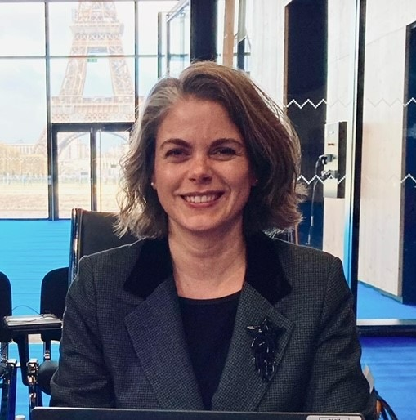
Since 2023, Sophie Morel has been the head of the Institutional Law Division at ESA. Previously, she was a legal officer for the Earth Observation Directorate, the legal officer for the Telecommunications and Integrated Applications (now Connectivity and Secure Communications) directorate and a legal officer in charge of employment law for institutional and human resource matters for the agency.
Morel holds a Master of Law from the University of Lausanne and University of Basel and a Ph.D. in international criminal law. She was an apprentice lawyer in the law firm Maire, Freymond & Associés, in Lausanne in Switzerland and was a law clerk at the Tribunal d'arrondissement de la Côte in Nyon, also in Switzerland.
Sophie Morel
Head of the Legal Services Department
European Space Agency (ESA)

Slide 6
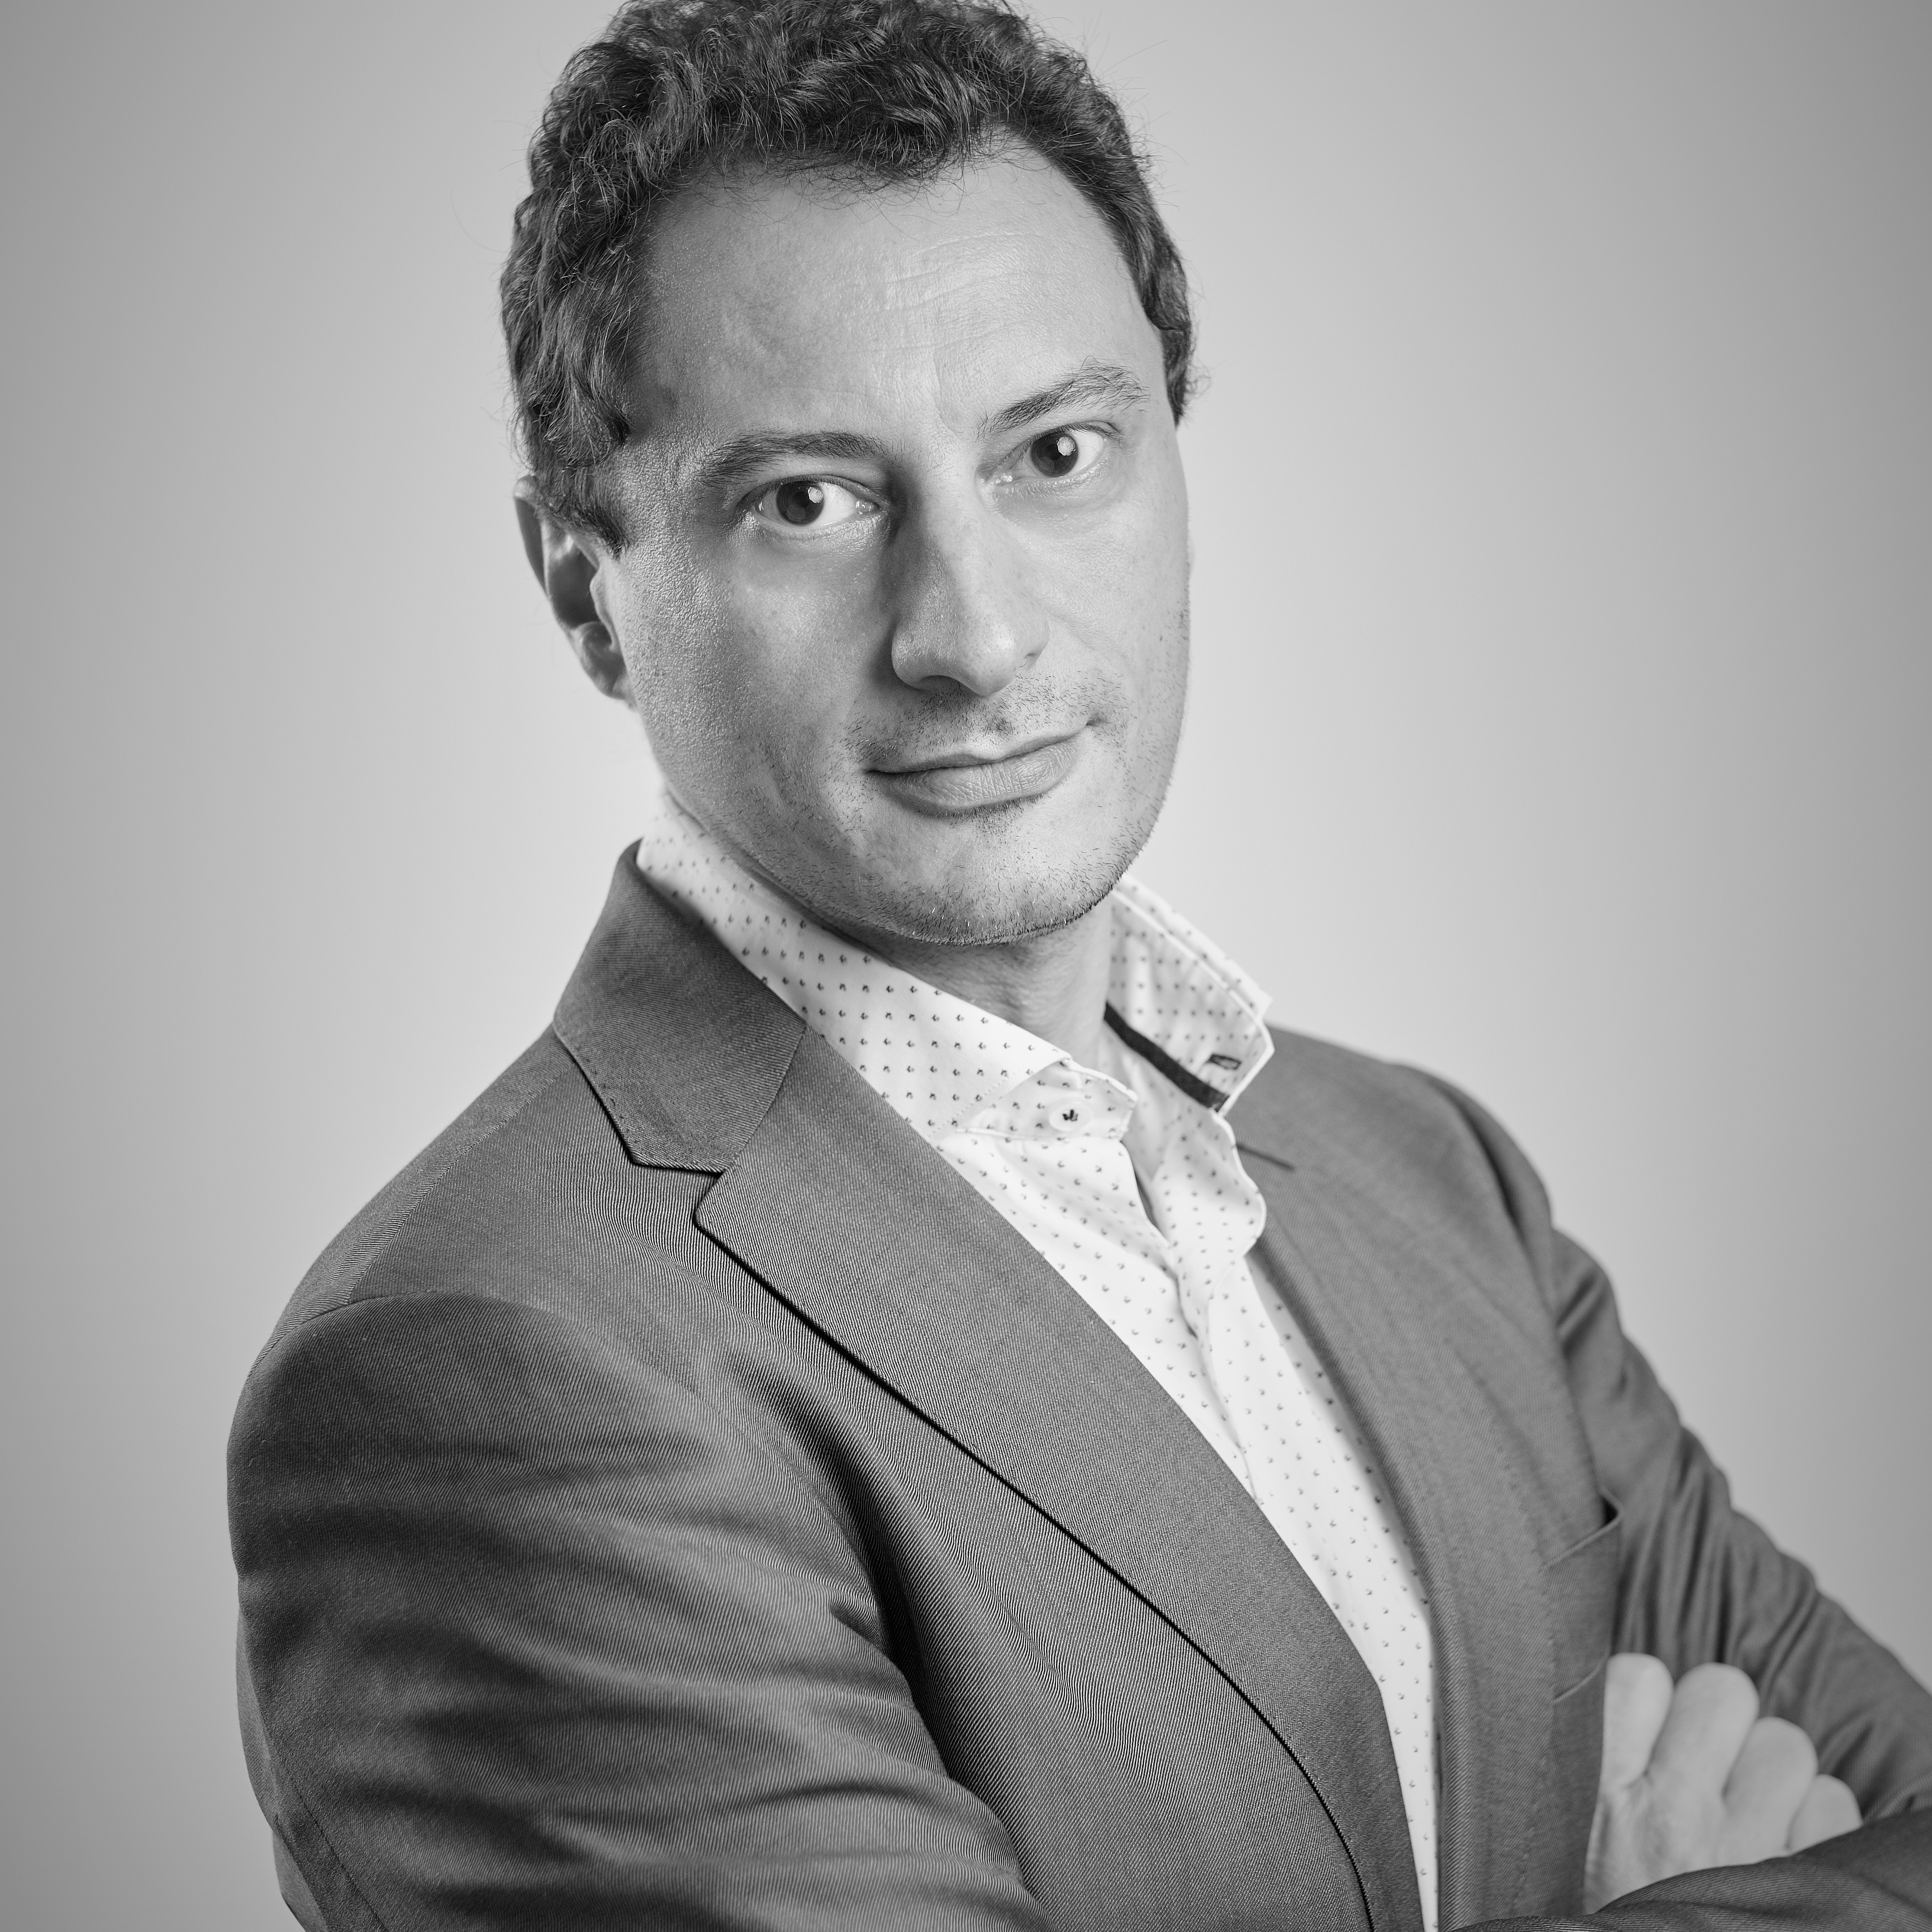
Stefano Iannitti has been an active contributor to the development of security in the European GNSS programmes since 2003.
From 2007 to 2011, he worked at the GSA for the establishment of the Galileo security accreditation process and of the Security Accreditation Board for European GNSS systems.
Iannitti took up his current position of head of Security at EUSPA in October 2015. Prior to that, he worked at the Agenzia Spaziale Italiana where he was also appointed as head of Galileo PRS Unit.
Iannitti holds a Master's degree in IT and network security, a Ph.D in systems engineering and a degree in computer engineering from “La Sapienza” University of Rome.
Stefano Iannitti
Head of Security Authority
EUSPA

Slide 7
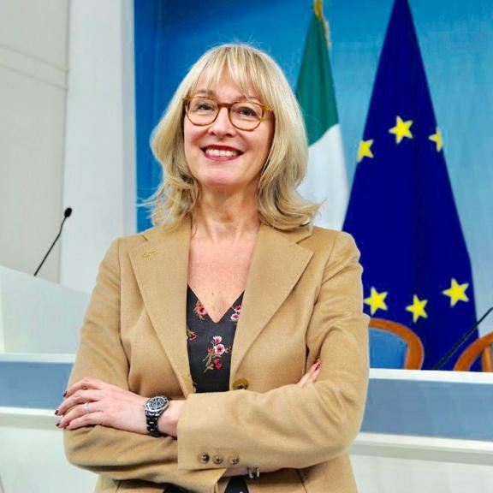
Elena Grifoni Winters has 35 years of technical and managerial experience in the international space sector, particularly working with NASA and ESA.
Winters was appointed in 2016 as head of Cabinet of ESA and, since September 2022, she serves as head of the Space Policy Office of the Italian Prime Minister’s Office.
Elena Grifoni Winters
Head of the Space Policy Office
Italian Prime Minister’s Office
Italian Government

Slide 8

Clémence Poirier is a Research Fellow at the European Space Policy Institute (ESPI) in Vienna, Austria. She has expertise on space cybersecurity issues and has conducted policy research on cyber threats on space systems as part of the war in Ukraine, the perception of cyber threats on satellites in French policies, and the applicability of data protection laws to satellite images.
Poirier previously carried out policy and legal research on the cybersecurity of the Australian space infrastructure for Flinders University in Australia. She is an active member of the SGAC’s Space and Cybersecurity Project Group and SGAC’s Space Generation Advocacy and Policy Platform co-lead on Responsible Behavior in Outer Space.
Poirier holds a Master’s degree in International Relations, International Security, and Defense from University Jean Moulin Lyon 3, France.
Clémence Poirier
Research Fellow
European Space Policy Institute

Slide 9
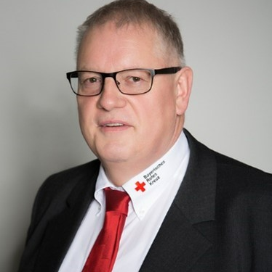
Uwe Kippnich is coordinator of security research at the Bavarian Red Cross Headquarter and is president of Public Safety Communication Europe. He is a high-level trained expert for the EU Civil Protection Mechanism.
Kippnich oversees the Bavarian Red Cross research activities and is involved in several research projects of the seventh Framework Programme (FP7) and Horizon 2020 (H2020) of the European Union. Moreover, he is involved in setting up new communication systems in the field of rescue services and for paramedics As a professional paramedic and male nurse, he combines expertise from the field with his research experience.
Kippnich has also been involved as a team leader in national and international missions, including being a platoon commander in the Medical Task Force in the Arthal region during the flash flood in the Western Germany in Summer 2021, where he worked closely with the Center for Satellite-based Crisis Information from the German Aerospace Center (DLR).
Uwe Kippnich
Coordinator Security Research
Bavarian Red Cross

