Slide 1
Opening Session

Slide 2
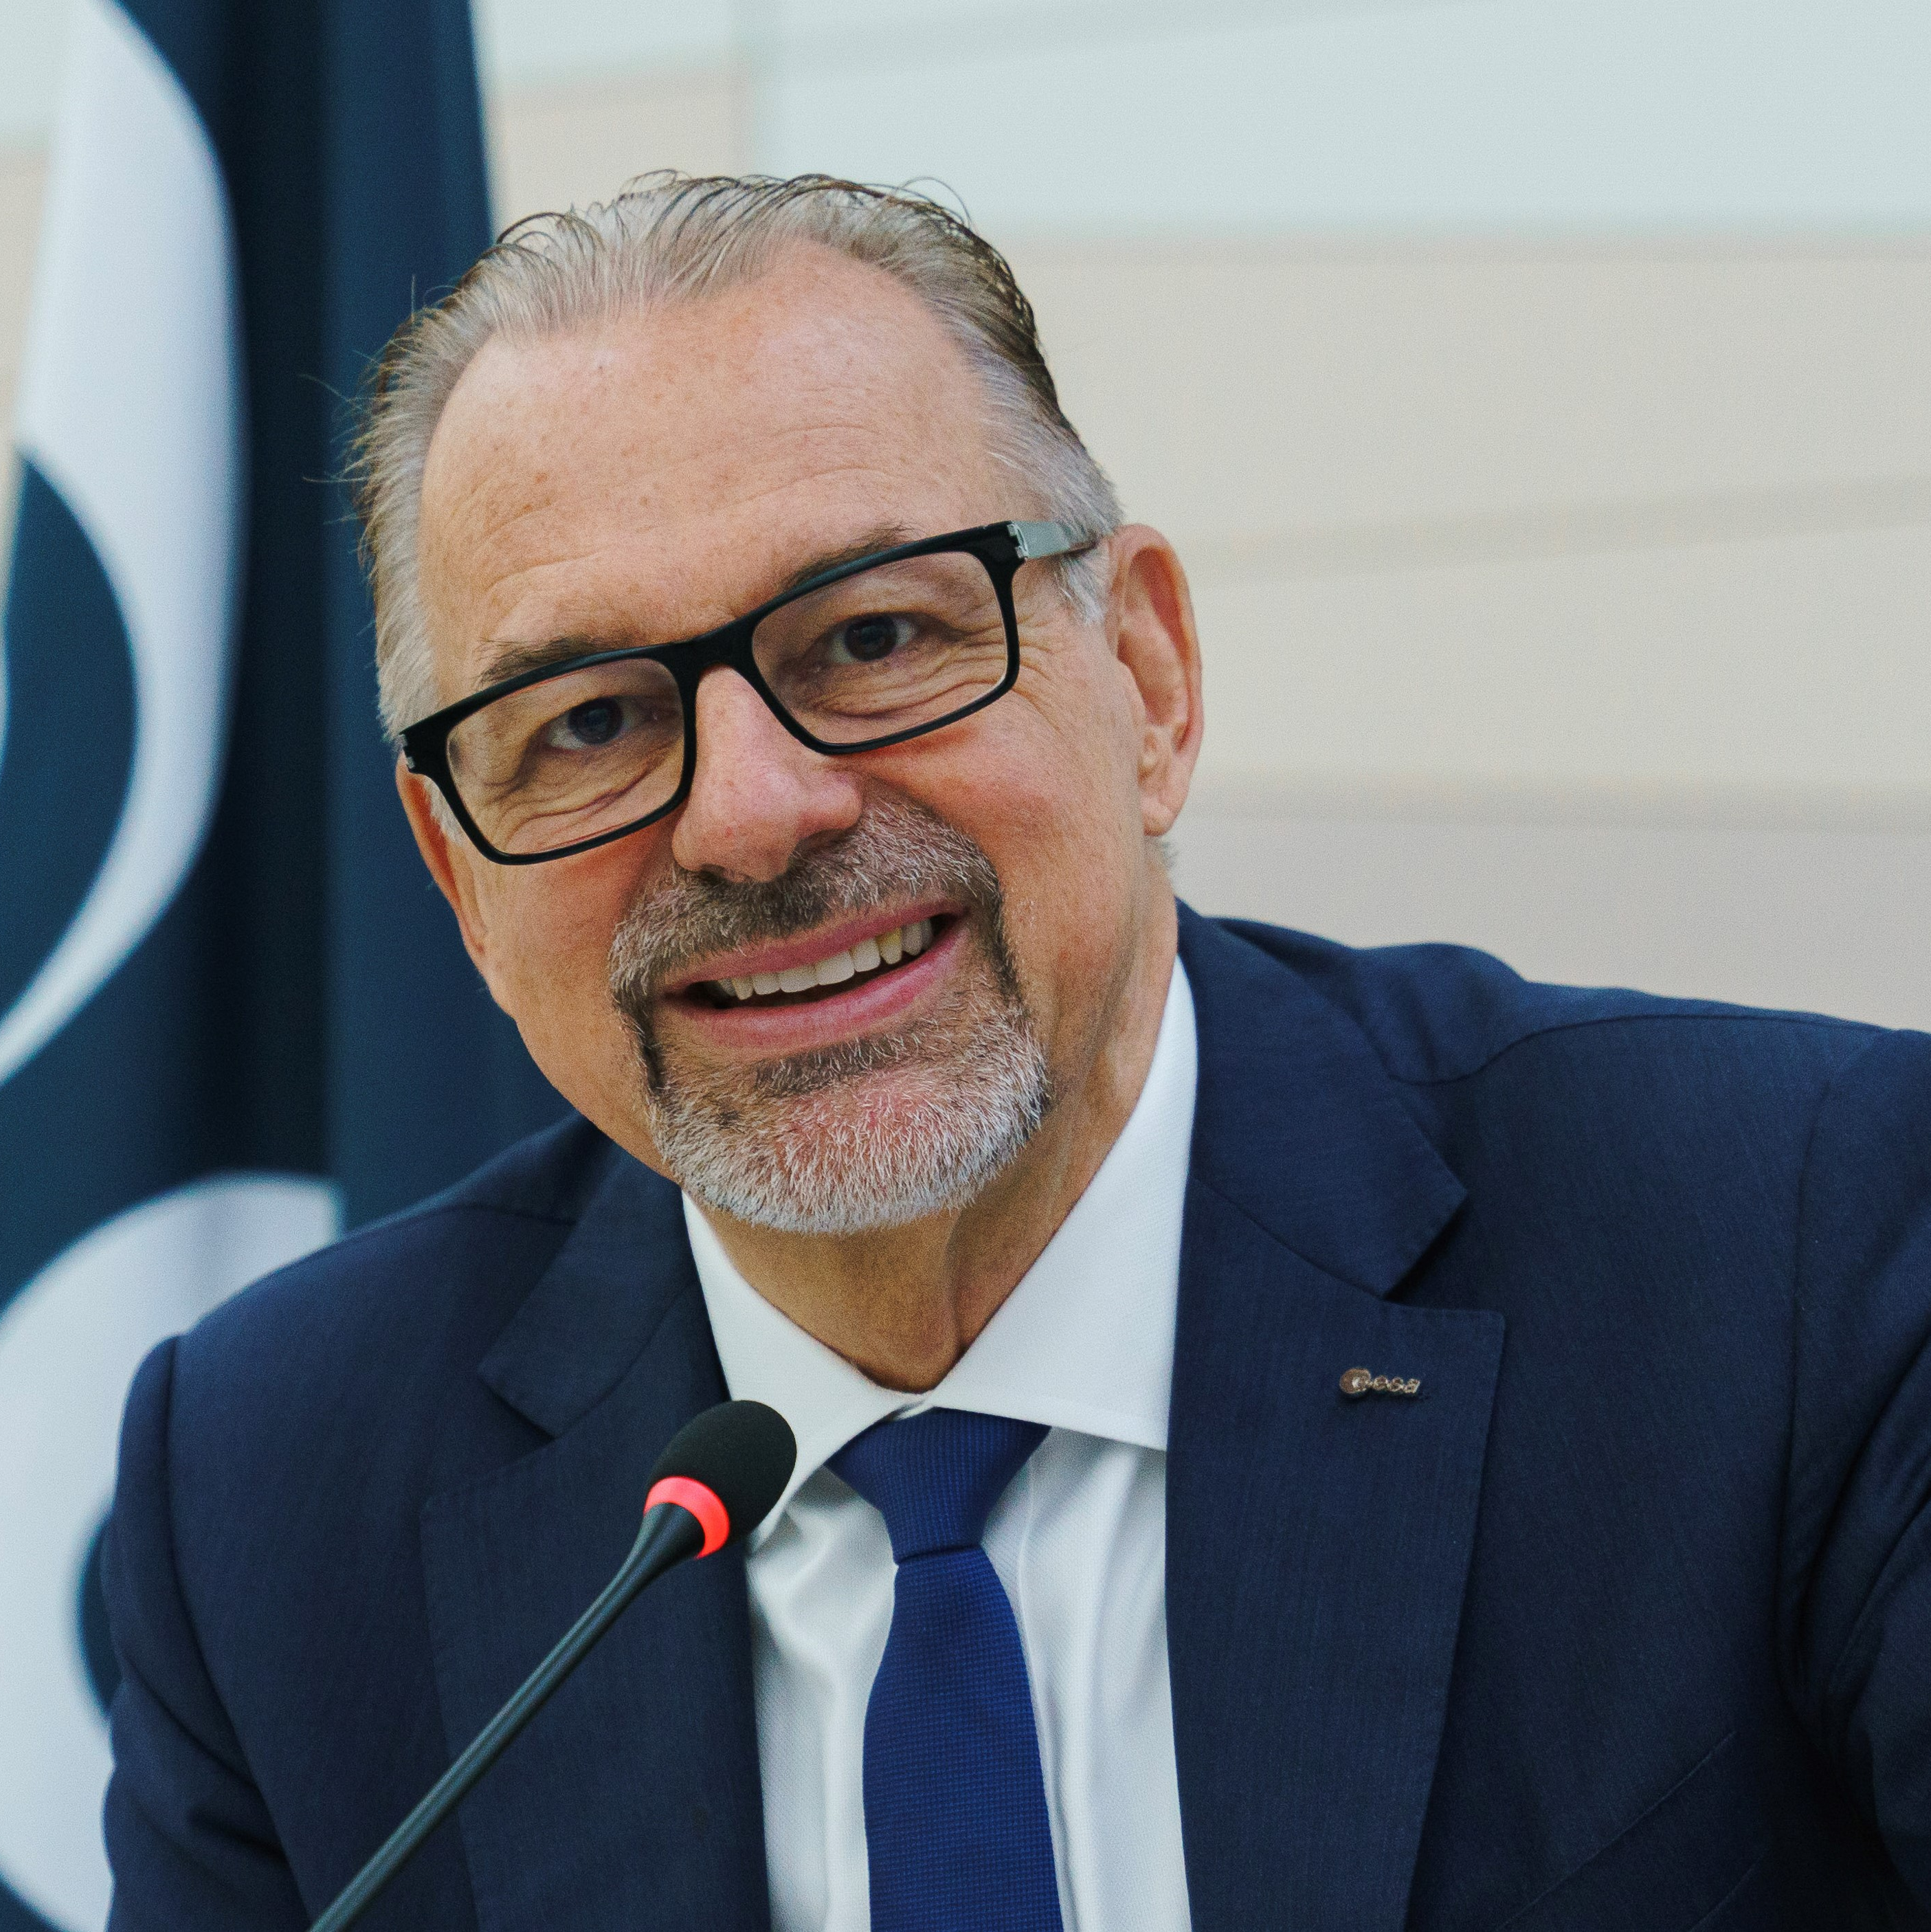
Josef Aschbacher graduated with a Master’s degree and a Ph.D in natural sciences from the University of Innsbruck. He has had an accomplished international career in space, spanning more than 35 years.
As chief executive officer of ESA, Aschbacher is responsible for the definition, implementation and development of Europe’s space infrastructure and activities. He is responsible for an annual budget of €7 billion and a workforce of 5500 distributed across several establishments, principally in Europe.
Previously, Aschbacher worked in various functions within ESA from 2001 onwards both in Paris and Frascati. He also served as scientific assistant to the director of the Space Applications Institute at the European Commission’s Joint Research Centre. From 1991–1993, he was stationed as ESA representative in Southeast Asia, where he developed projects in the Asian region while working in a full-time academic teaching capacity as Associate Professor at AIT Bangkok.
In 2021, Aschbacher became 'Grande Ufficiale Ordine al Merito della Repubblica Italiana', the highest recognition accorded to non-Italian nationals.
Josef Aschbacher
Director General
European Space Agency (ESA)

Slide 3
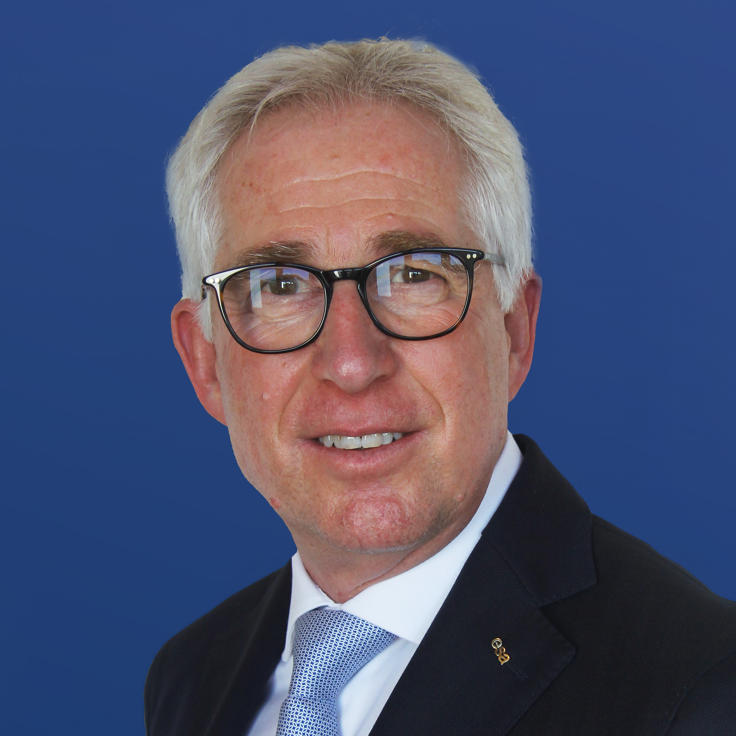
Francisco-Javier Benedicto Ruiz studied at the Polytechnic University of Catalonia, graduating with a Master of Science in telecommunications engineering in 1981.
He has accomplished an international career in space, with over 40 years’ experience at ESA, university and industry.
He has held within ESA various engineering and managerial posts in the development of fixed, broadcast and mobile satellite communication systems and led the development of Europe’s satellite navigation systems EGNOS and Galileo.
As ESA Director of Navigation, Francisco-Javier Benedicto Ruiz is responsible for the definition, planning and execution of ESA’s navigation programmes and contributes to ESA-wide management, supporting the ESA Director General in the pursuit of ESA’s overall objectives.
He has over 100 publications in technical journals and conferences, holds several international ESA patents and has been recipient of several honours and awards.
Francisco-Javier Benedicto Ruiz
Director of Navigation
Acting Director of Connectivity & Secure Communications
European Space Agency (ESA)

Slide 4
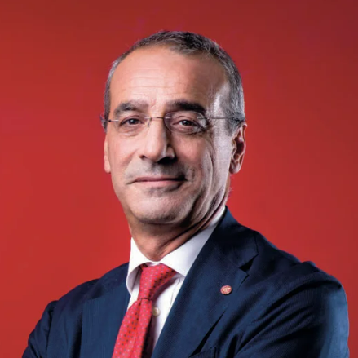
Teodoro Valente is the new president of the Italian Space Agency. He is director of the Institute for Polymers, Composites and Biomaterials of the National Research Council. For many years he was a full professor at Sapienza University in Rome and also served in the Research and Development Directorate of the European Commission. Valente graduated from Sapienza University in 1989 with a degree in mechanical engineering and in 1993 he completed a master's degree in business administration at Luiss.
Between 1990 and 1992 he worked for Snamprogetti and Tecnolyte. From 1992 he began his university career as a researcher at Sapienza University; from 1996 to 1997 he was seconded to the European Commission's Directorate for Research in Brussels as a national expert for scientific and technological cooperation actions in the field of materials research. During the same period he was scientific secretary of the European 'Cost ad hoc Technical Committee on Materials'. In 1998 he became an associate professor at Sapienza University and has been a full professor at the same university since 2001.
Teodoro Valente
ASI President

Slide 5
Session 1
AMBITIONS
INNOVATIVE SERVICES & APPLICATIONS USING SPACE CAPABILITIES

Slide 6
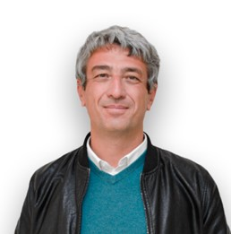
Gianluca Casagrande is a full professor of geography at the European University of Rome, scientific director of the Geographic Research and Application Laboratory (GREAL) and member of the Italian Geographical Society and of Association Polarquest (Switzerland).
He was the onboard scientist during the Polarquest2018 and Polarquest2021 Arctic expeditions to Svalbard. Casagrande's current research interests include geo-technologies, historical geography and exogeography.
Gianluca Casagrande
Full Professor of Geography
European University of Rome

Slide 7
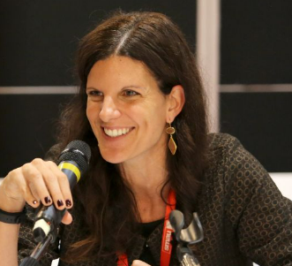
Debora Marullo is the EU Programmes & Innovation Department Head at the Port Network Authority of the Ionian Sea (PNAIS), a role she has been in since 2021.
Marullo is a former coordinator of the PNAIS General Secretariat, also involved in EU Projects and start up acceleration programmes. She has more than 24 years’ professional experience in project management, specialising in technical assistance, monitoring, control and evaluation in the subsidised finance field.
Debora Marullo
EU Program. and Innovation Dpt
Port Network Authority of the Ionian Sea (Port of Taranto)

Slide 8
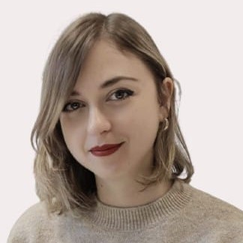
Gabriella Nenna is the Director of the CARA in Brindisi, an Italian government centre for the reception of immigrants managed by Consorzio Hera Onlus. She graduated from the university of Salento, specialising in psychoanalytic psychotherapy and has held the position of director at various reception centres, working with a view to promoting the health and wellbeing of migrants.
Since 2021 she has been appointed municipal guarantor of the rights of people with disabilities. Additionally, she collaborates with newspapers by writing articles of social interest, analysing issues relating to the youth population.
Nenna is a member of the Italian Society of Emergency Psychology Social Support Federation, a non-profit association, which operates in situations of micro and maxi emergencies on the Italian territory for the prevention and treatment of victims and rescuers at risk of psychological pathologies related to trauma. She has also carried out psychological support and vulnerability detection at hotspot centres, C.P.R. and S.A.I.
Gabriella Nenna
Director of Cara Restinco-Brindisi
Hera Consortium

Slide 9
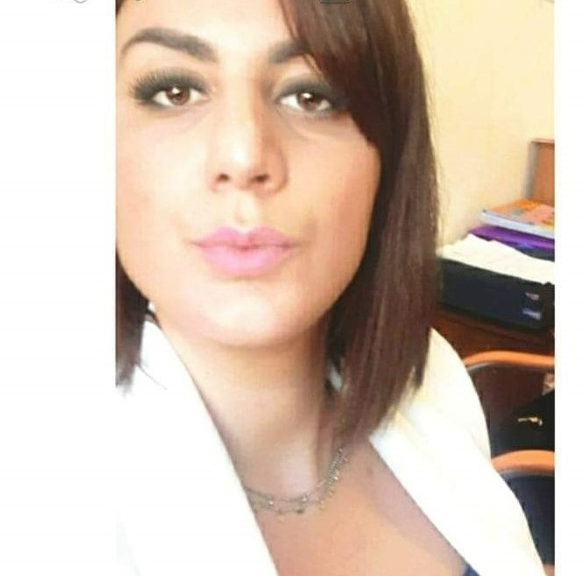
Francesca Carrozzo is a director and intercultural mediator in detention and repatriation at the Camp of Restinco, which is managed by Consorzio Hera Onlus. She holds a Master’s degree in immigration and political asylum mediation as well as a master’s degree in dynamics for Intercultural linguistic mediation.
Carrozzo is also an intercultural mediator at prisons and in voluntary projects such as the Italian Council for Refugees to promote initiatives for the emancipation of non-EU citizens and exploited non-EU workers in the Salento countryside.
She is a director of different reception centres for asylum seekers as well as at centres such as Hotspot.
She has collaborated with the Italian Council for Refugees in the work camp of seasonal migrants for the self-determination and emancipation. Carrozzo currently resides on the Island of Lesbos to welcome refugees from the sea.
Francesca Carrozzo
Intercultural Mediator
Hera Consortium

Slide 10
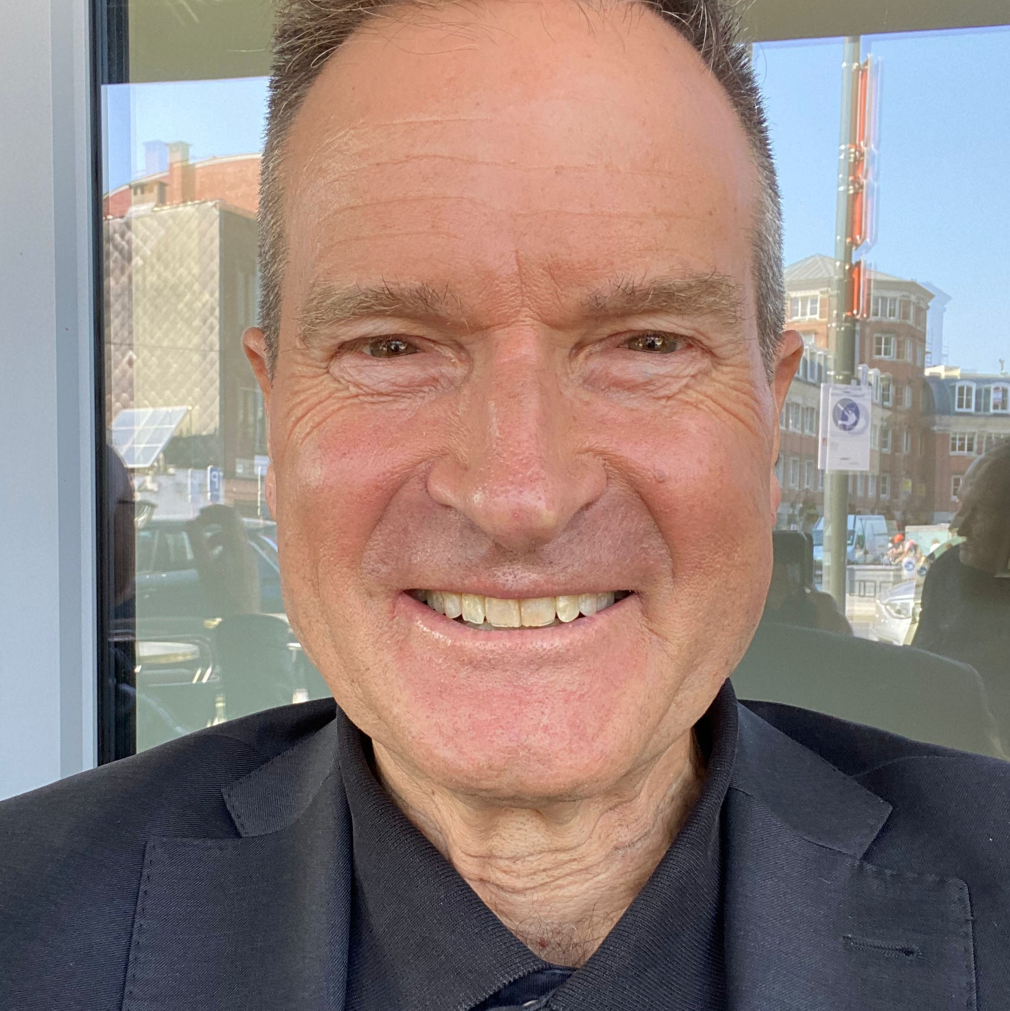
Chris Burns is a Franco-American journalist, moderator and media expert with decades of reporting experience in Europe, the U.S., Africa, Central Asia and the Middle East. He has covered wars, terror attacks, election battles, financial crises, disasters and film festivals.
For Euronews he worked on magazine shows around the world and hosted the hard talk show “The Network”. He was a Bloomberg TV financial reporter based in Brussels and Berlin, and a CNN correspondent based in Germany and the White House. Burns also reported for the Associated Press based in Paris, New York and Nashville.
Burns serves as a media consultant, media trainer and video producer, and has moderated panels for the World Economic Forum, OECD, OSCE, United Nations, World Bank, EU institutions, NGOs and the private sector. He graduated in political economy at the University of California, Berkeley, and completed postgraduate studies in Europe.
Chris Burns
Moderator

Slide 11
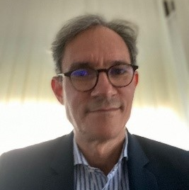
Antonio Bartoloni is director general for “Industrial reconversion and large industrial productive chains” of the Italian Ministry of the Economic Development. During the last ten years, he has been involved in the design and implementation of innovation policies and programs of national importance to enforce the competitiveness of the Italian productive system.
Bartoloni represented the Ministry, with different roles, along all the steps of the complex process of defining and implementing the new national Space governance. In this context, he coordinated the definition of the National “Space Economy” Strategic Plan in collaboration with national and regional institutions.
Before joining the Ministry he spent 15 years in the space industry sector, working as a research scientist and a project /program manager in the field of remote sensing data processing for applications. It is here where Bartoloni was involved in relevant European and national satellite missions, like ERS-1/2, ENVISAT and COSMO SkyMed.
Antonio Bartoloni
Director General of "riconversione industriale e grandi filiere produttive"
Italian Ministry of Economic Development (MISE)

Slide 12
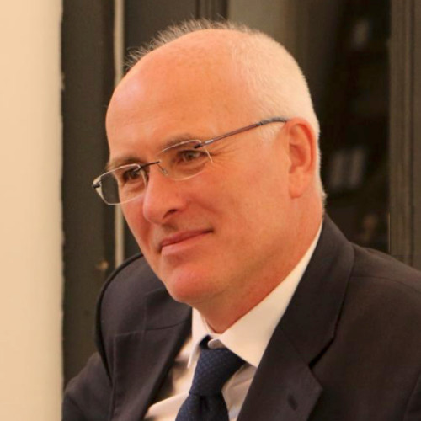
Nick Appleyard heads up the ESA's support for sustainable businesses using space. This comprises project funding and support to innovating companies and their customers.
Appleyard’s previous background includes leading the UK government's innovation support for the digital economy, and its data applications which now motivate the dramatic growth of the commercial space industry.
Nick Appleyard
Head of Space Solutions Department
Directorate of Telecommunications & Integrated Applications
European Space Agency (ESA)

Slide 13
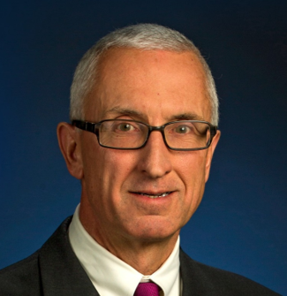
Mark McGranaghan is a fellow at the Electric Power Research Institute (EPRI). He provides technical and strategic input and guidance across the organisation and for the electric utility industry around the world. McGranaghan holds a Bachelor of Science and Master of Science in electrical engineering from the University of Toledo and Master of Business Administration degree from the University of Pittsburgh.
McGranaghan has authored more than 70 technical papers and
articles on topics ranging from power quality to insulation coordination of extra high-voltage (EHV) systems. He has been a leader in the development of smart grids for the last 20 years. McGranaghan is also an IEEE Fellow and, in 2014, received the Charles Proteus Steinmetz Award for his expertise and dedication to power engineering standards development and is co-author of the book, Electrical Power Systems Quality.
McGranaghan has been with EPRI since 2003. He led EPRI research in the smart grid area and coordinated closely with government smart grid demonstrations and other worldwide efforts.
Mark McGranaghan
Vice President of Technology Innovation
Electric Power Research Insitute (EPRI)

Slide 14
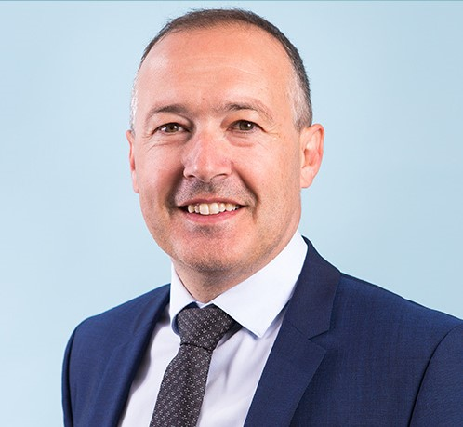
Natale Lettieri is an expert in satellite telecommunications systems, specialising in the operational management of satellite systems and services. He graduated with top grades in telecommunication engineering from the University "Federico II" of Naples, Italy.
With over 20 years of experience in the field, he has gained extensive involvement in managing critical satellite ground segment infrastructures, overseeing complex programs, and delivering excellent services to customers.
Currently serving as the chief transformation officer at Eutelsat, Lettieri is a member of the company’s Executive Committee. In this role, he is responsible for coordinating the implementation of several programmes aimed at reforming Eutelsat's business models and leveraging the full potential of new GEO/LEO markets.
Previously, Lettieri held the position of chief service operation officer at Eutelsat, where he was responsible for the overall engineering and operations of Eutelsat's ground segment services and infrastructures.
Natale Lettieri
Chief Transformation Officer
Eutelsat

Slide 15
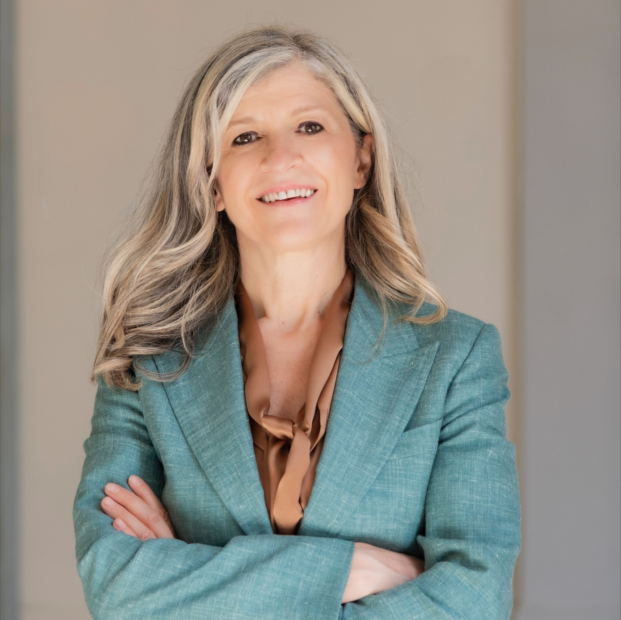
Anna Masuttti is the Chairperson of West Sicily Gate, a JV between MSC Cruise S.A & Costa Crociere, a Member of the Board of Directors at F2AC Finance to Aerospace Consulting and a Member of the Board of Directors at Pelliconi & C. Masutti is also Chairperson of Audit and Risk Committee of RFI and holds lectureships in schools of law and engineering at academic institutions in Bologna and Florence. She also holds executive and partner positions on a variety of committees and boards as well as at universities and law firms.
From 2004 to 2005, Masutti was appointed by the European Commission as legal member in support of a consortium led by Thales Alenia Space for the preparation of the governance framework for the realisation of the Land Surveying and Civil Engineering Project. From 2006 to 2008, Masutti worked with Finmeccanica on the proposal for European legislation for the governance of European satellite programmes submitted by the Italian government to the European Commission (DG MOVE). Since 2023, she has been a legal expert in the DCESS project, Optimising Synergies Between Data Centres and Energy Systems.
Anna Masutti
President
Rete Ferroviaria Italiana

Slide 16
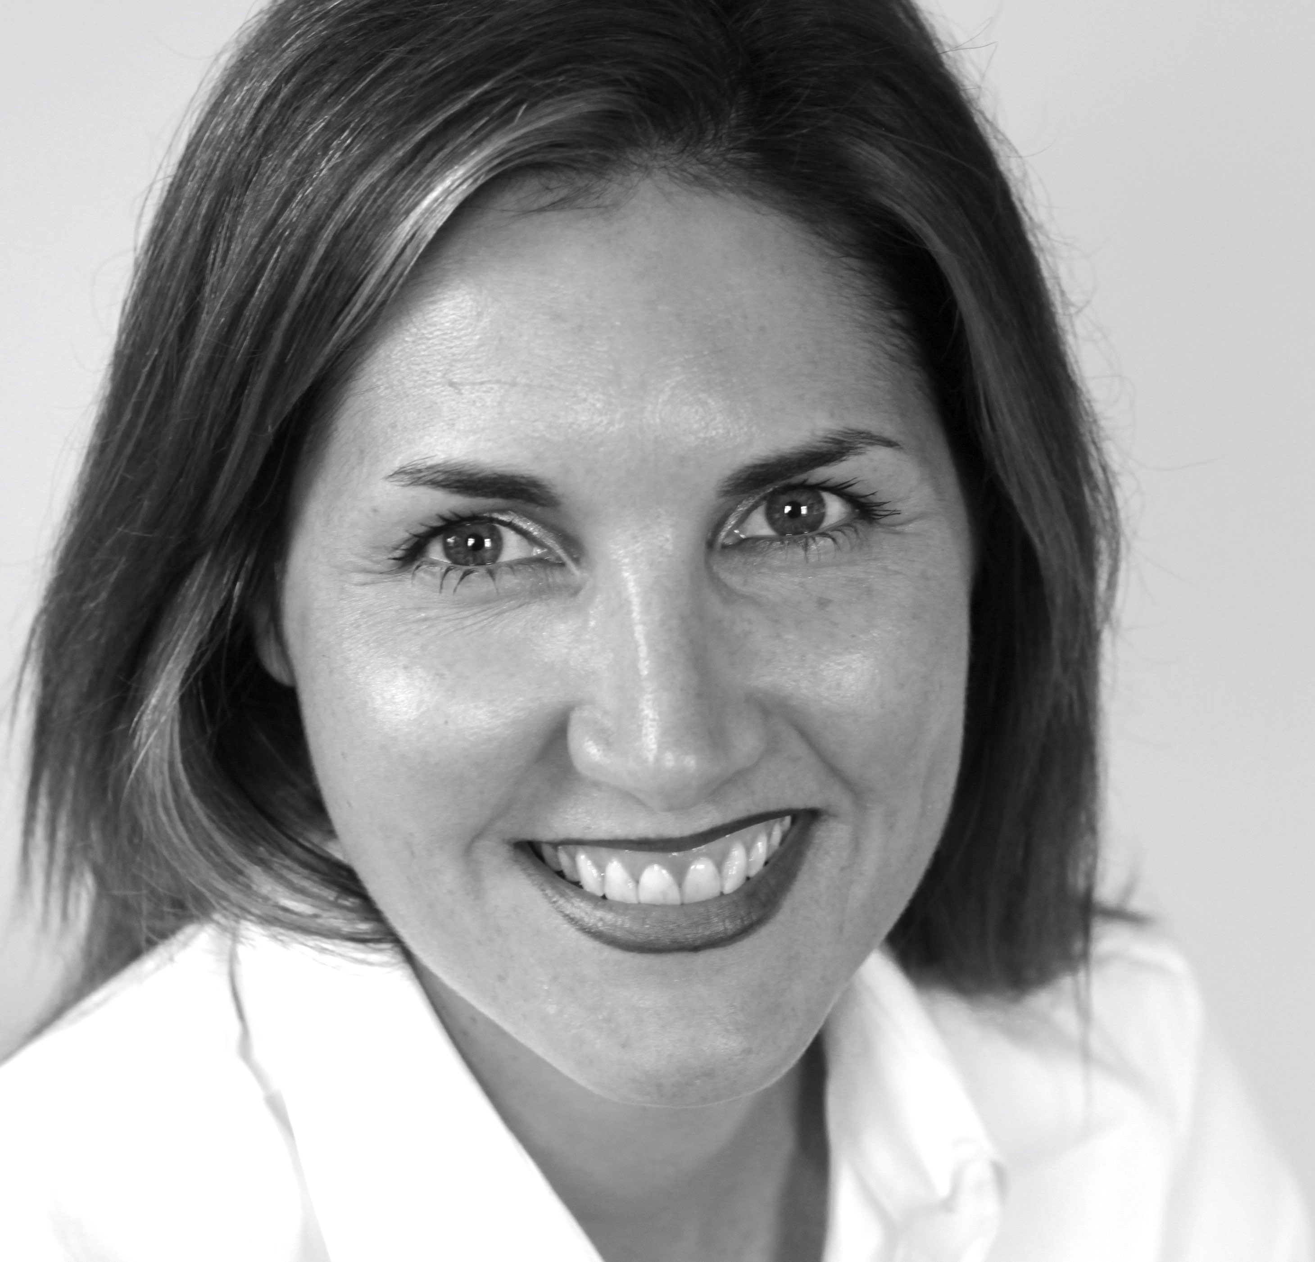
Cheryl Hicks is a senior advisor at the United Nations Global Compact’s CEO Water Mandate, and the lead on the innovation and investment strategies of the Water Resilience Coalition and WASH4Work initiatives.
From 2015-2020, Hicks has been the inaugural executive director and CEO of the Toilet Board Coalition. She has served on the boards, investment and impact committees of impact investment firms and international committees on water, sanitation and health.
Throughout her career, Hicks has co-founded several high performing partnerships aligning business, innovation and investment for sustainable development.
Hicks holds a Bachelor's in international relations and environmental science from the University of Western Ontario (UWO) in Canada and a Certificate in Business and Finance Leadership from the International Institute for Management Development (IMD) in Switzerland.
Cheryl Hicks
Senior Advisor,
CEO Water Mandate
United Nations Global Compact & Pacific Institute

